Slide 1
E- Restaurant Application using firebase and Stripe Integration
Submitted By: Akash Pathania
Enrollment No: O23MCA110008
Chandigarh University(MCA23-25)

Slide 2
Introduction
E-commerce has revolutionized how restaurants operate.
Customers demand online access to menus, quick ordering, and real-time updates.
This project provides a web-based platform for both customers and restaurant admins using the MERN stack.

Slide 3
Objective
Build a responsive online food ordering system.
Enable admin to manage products and orders.
Simplify the ordering process for users.
Provide real-time data handling and secure login.
Hosted on GitHub: https://github.com/akashp-007/Restaurant-E-Commerce-Website-main

Slide 4
Technology Stack
Frontend: React.js, HTML, CSS
Backend: Node.js, Express.js
Database: MongoDB
Other Tools:
Postman for API Testing
Visual Studio Code
Git & GitHub

Slide 5
System Features
User Registration
View Products / Menu and Login
Add to Cart and Checkout
Stripe Payment gateway Integration
Login using firebase
Secure APIs using JWT

Slide 6
SDLC Phases
Requirement Analysis
System Design
Frontend and Backend development
Integration
Testing
Deployment and Maintenance

Slide 7
Implementation
Frontend: Developed using React components
Backend: RESTful APIs in Express.js
Database: MongoDB schema for users, orders, and items
Authentication: Secure login via JWT and hashed passwords using bcryptjs

Slide 8
Testing
Unit Testing of Components
API Testing using Postman
Bug fixes through iterative testing

Slide 9
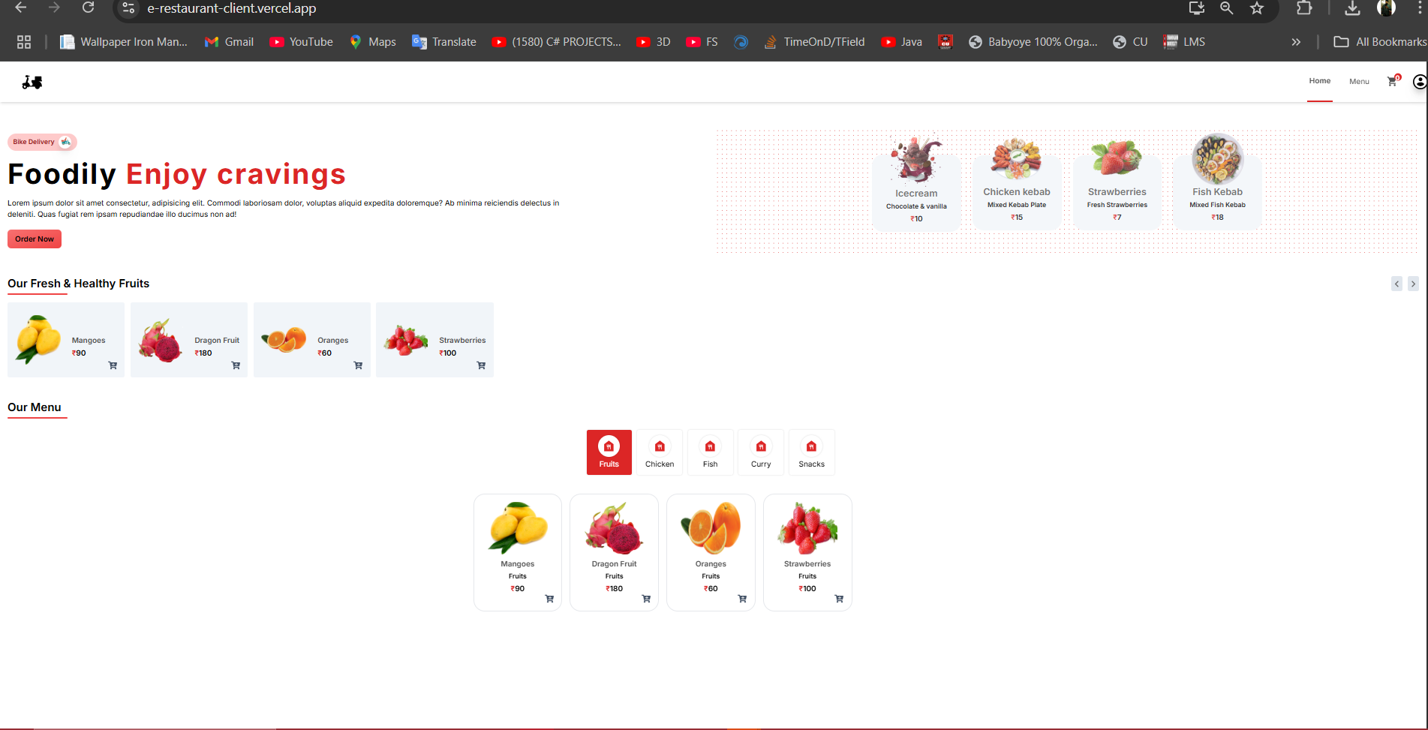
Application Screenshots
Homepage / Product List

Slide 10
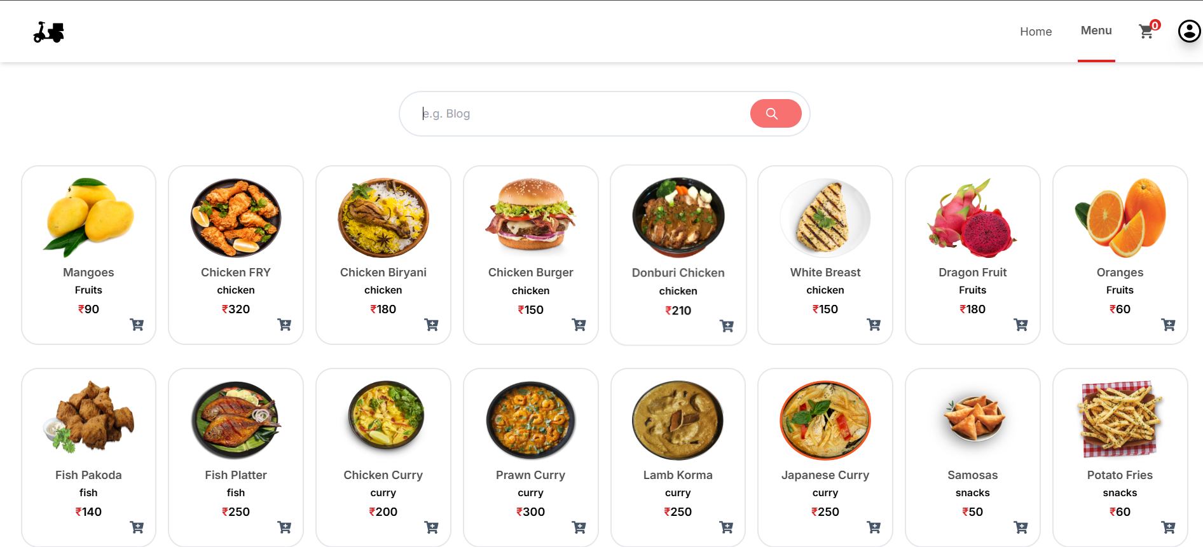
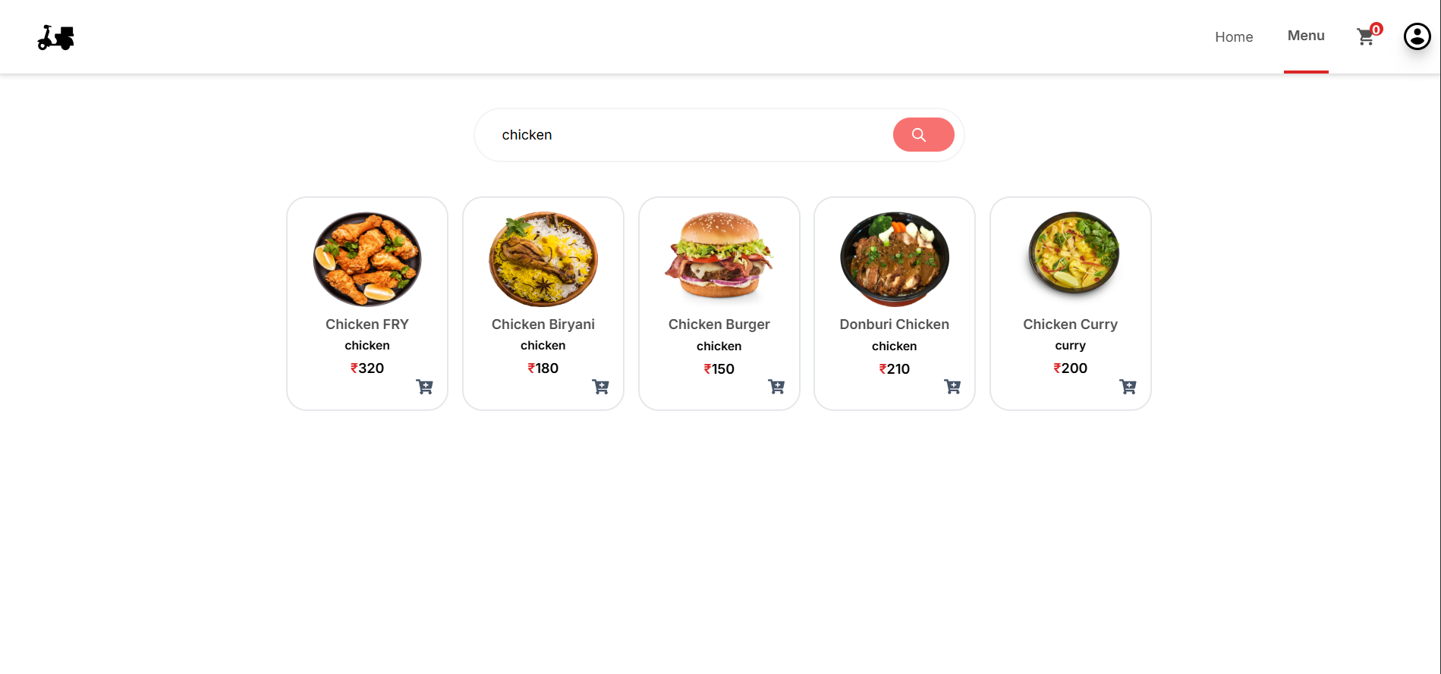
Menu
Search Functionality

Slide 11
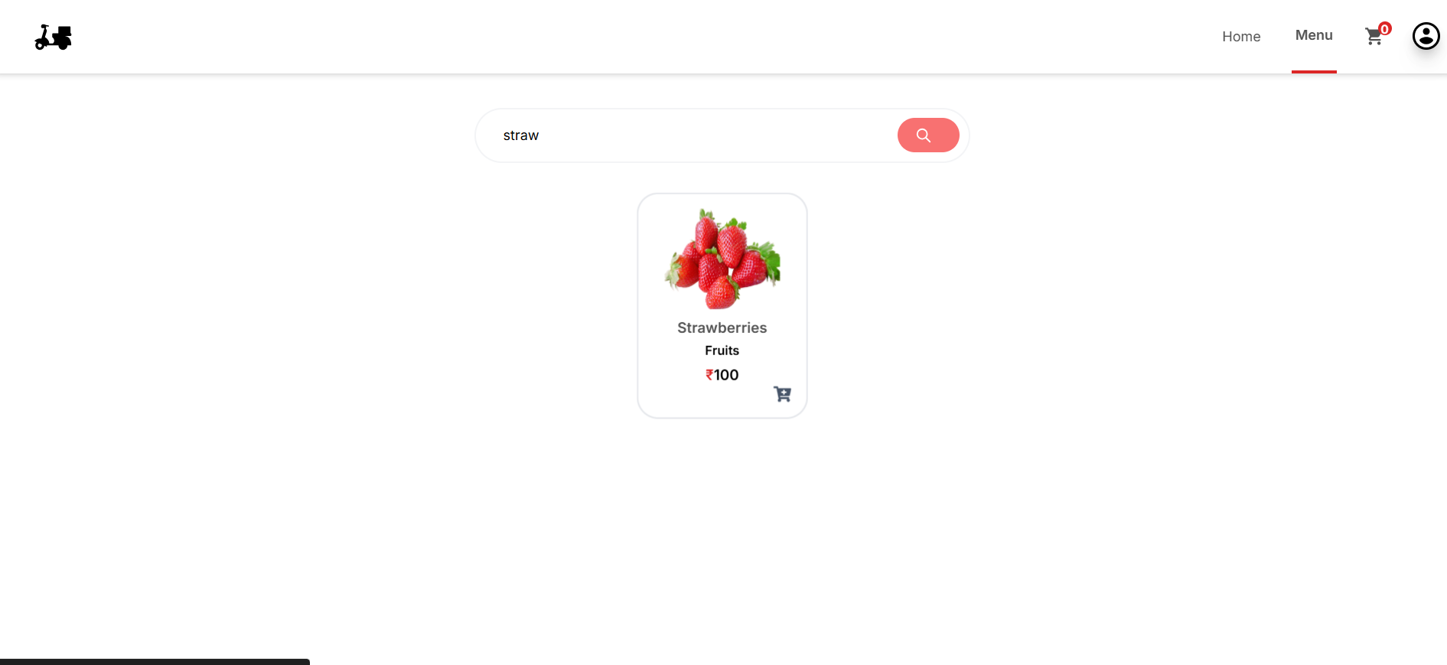
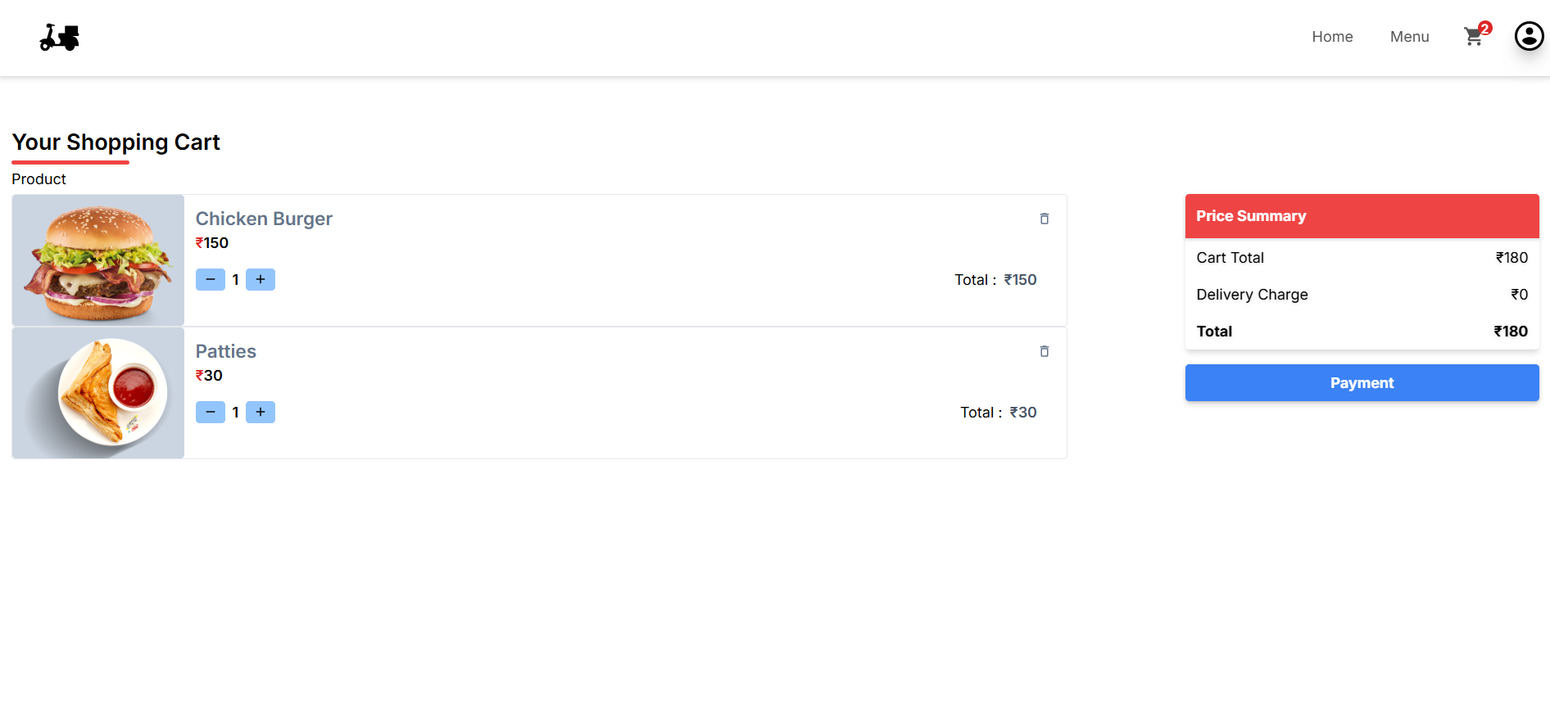
Partial Search Results
Cart

Slide 12
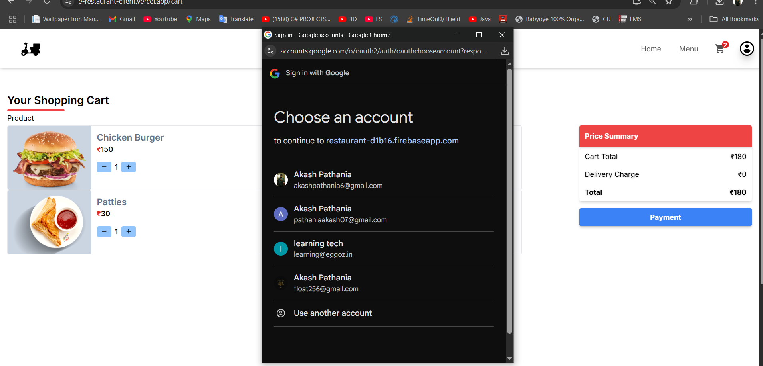
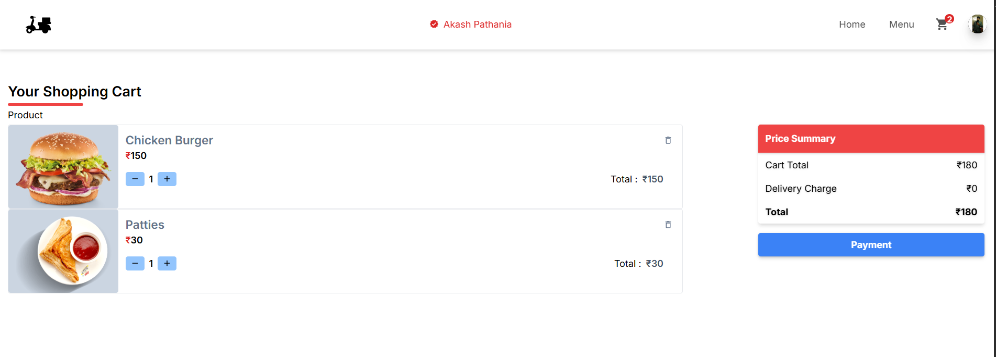
Login
Logged In

Slide 13
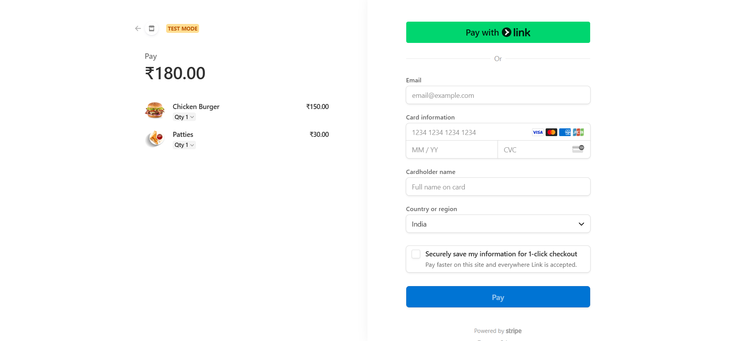
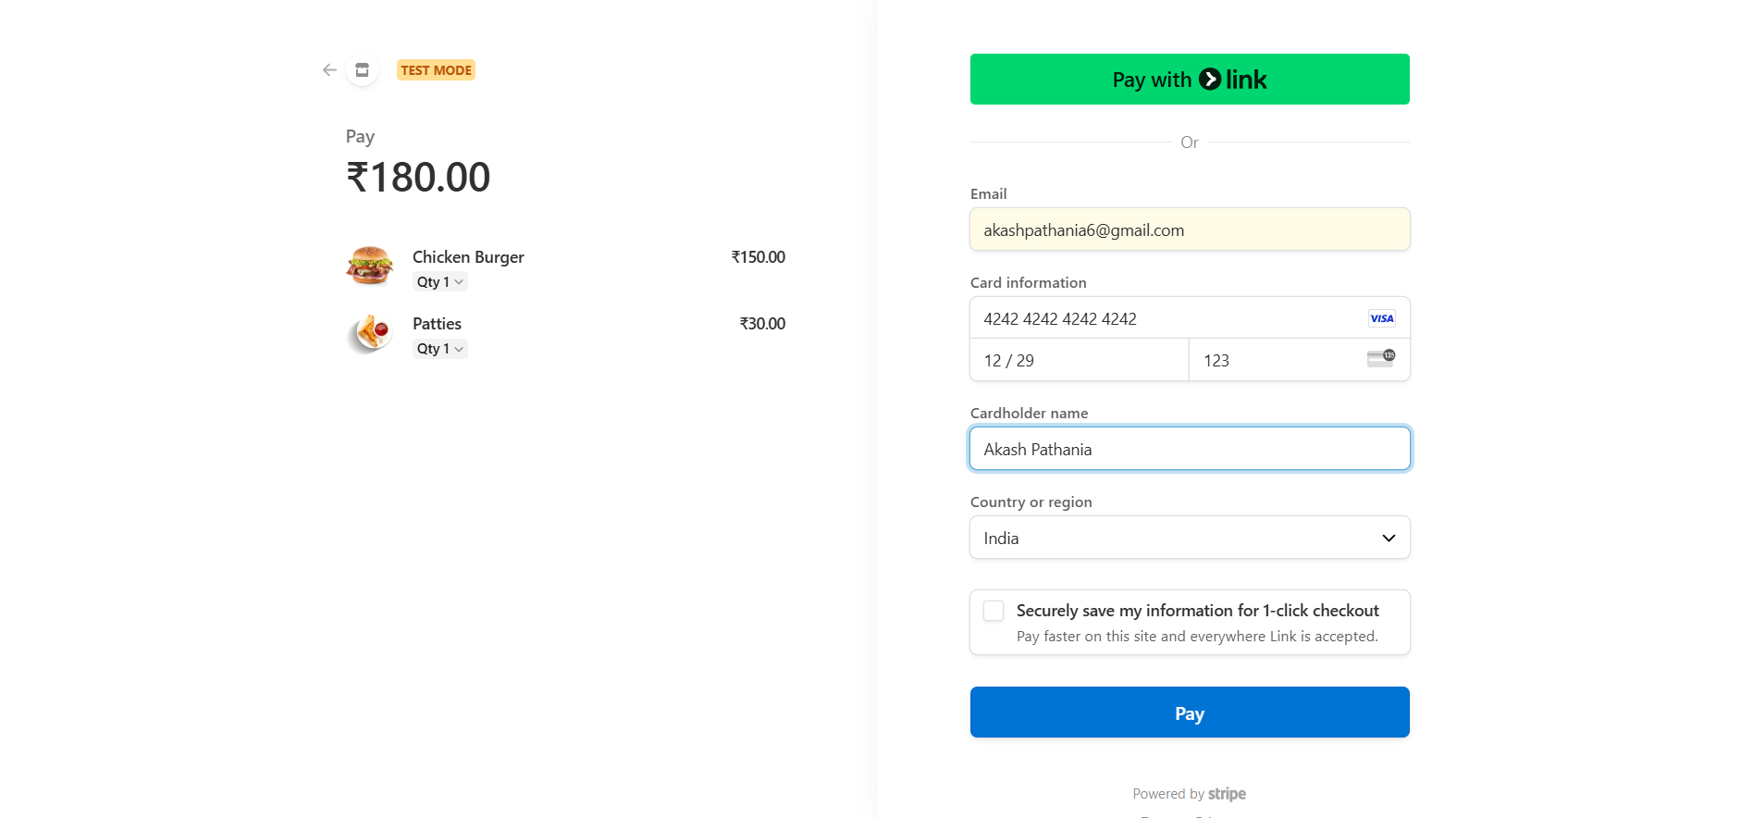
Payment Details
Details Entered

Slide 14
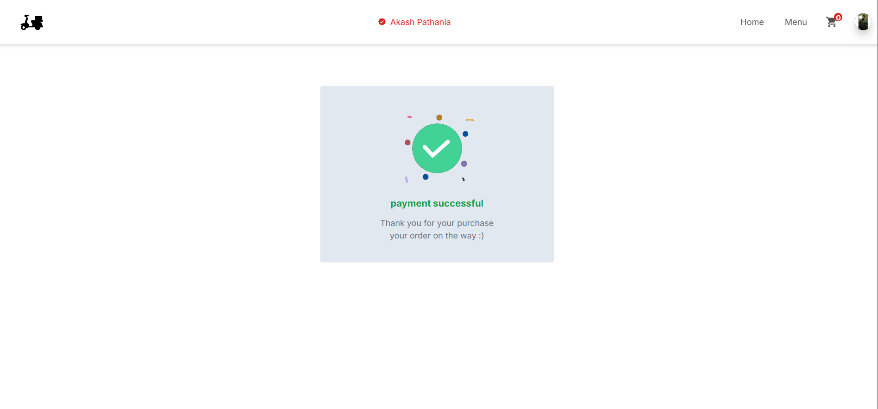
Purchase Success

Slide 15
Conclusion
Developed a scalable, modern web application using the MERN stack.
Automated ordering and admin management.
Easy to extend: online payments and login.
Great learning experience in full-stack development.

Slide 16
Bibliography (APA Style)
W3Schools. (n.d.). React JS Tutorial. Retrieved from https://www.w3schools.com/react/
Mozilla Developer Network (MDN). (n.d.). JavaScript Documentation. Retrieved from https://developer.mozilla.org/
MongoDB Inc. (n.d.). MongoDB Documentation. Retrieved from https://www.mongodb.com/docs/
Express.js. (n.d.). Getting Started. Retrieved from https://expressjs.com/

Slide 17
Thank You

